Slide 1
The benefits of non formal learning in critical pedagogical contexts ATEE Spring Conference, Riga 12-13th May 2017 Emanuele Micheli, Fiorella Operto School of Robotics, Italy
This project has been funded with support from the European Commission under the Erasmus+ programme (2015-1-IT02-KA201-015141). This website reflects the views only of the authors, and the Commission cannot be held responsible for any use which may be made of the information contained therein.

Slide 2
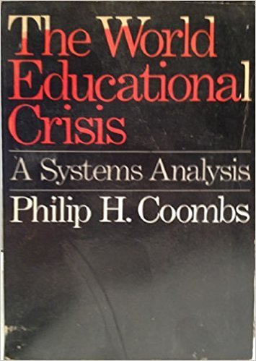
1968

Slide 3
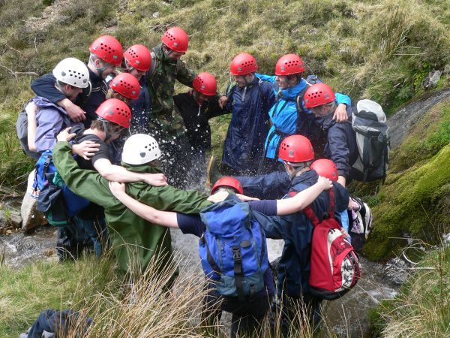
The World Educational Crisis
Since 1945 all world countries underwent extraordinary changes
and
the educational progress has been substantially greater than
predict in the early 1950s.
BUT
Educational systems adapted too slowly
Disparities:
old curriculum
Imbalance between education and employment
Inequalities among social groups
Gap between rising costs of education and public funding
Inertia of the educational systems themselves
Effect:
Preoccupation with linear expansion detrimental to courage and innovation
Crisis of confidence in Education
Itself

Slide 4
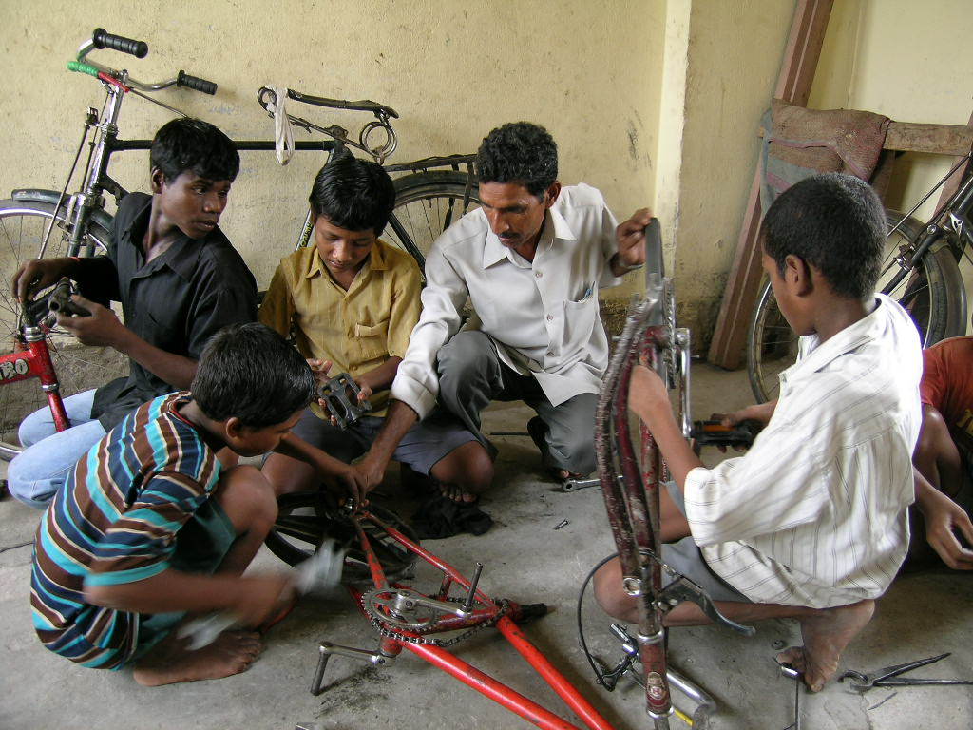
Non formal Learning
Based on the psychological and cognitive study of infant cognitive development, and of learning process in the baby, kids and adults (Piaget, Vygotsky, Montessori, ..)
Applied in critical situations to psychological recovery of traumatic kids, and in case of psychological disorders;
Applied (how sadly ☹) outside of the educational establishments
Based on experiments of learning in communities, intergenerational, peer education in real situation
Importance of non verbal learning (watching and doing)
EFFECTS:
Opening
Innovation
Communities
Mutual adaptation society/
educational systems
Real learning situations

Slide 5
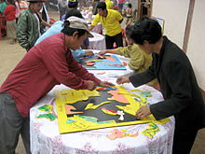
Innovate the educational environment
Starting as early as possible (educational deprivation, boredom..)
Involve parents (educating community)
Story Telling (giving to facts their identity)
Gaming, Gamification (like a researcher)
Learning Scenarios (the wholeness)

Slide 6
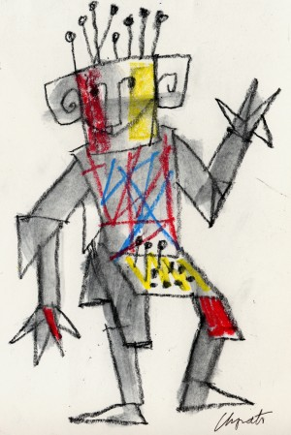
THANK YOU! ☺
operto@scuoladirobotica.it
European Centre for the Development of Vocational Training
Cedefop has created European guidelines to provide validation to a broad range of learning experiences, thereby aiding transparency and comparability across its national borders. The broad framework for achieving this certification across both non-formal and informal learning is outlined in the Cedefop European guidelines for validating non-formal and informal learning; Routes from learning to certification.

