Slide 1
RoboESL activities at 56th Junior High School of Athens Activities and experiences from our implementations
12 May 2017 Riga, Latvia
Tassos Karampinis
Computer Science and ICT teacher at 56th Junior High School of Athens
Tassos Karampinis
Computer Science teacher, Med, MSc

Slide 2
Overview
Project description
Objective
General Impressions
Project Implementation and Methodology
Key Findings / Results
results 1
results 2
Conclusion

Slide 3
Project description: Objective
Objective
develop extra-curricular constructivist learning activities in schools that will encourage children at risk of failure or Early School Leaving (ESL) towards staying at school,
Make interventions based on the scenarios developed and discussed with the committee that support us in order to achieve the programs’ goals.
introduce robotic lessons in our school as:
computer science lessons
interdisciplinary technology-computer science projects,
use our new tools efficiently for all of our students
Notes:
Helping them improving their grades, practice and develop their creativity skills, raise self-esteem, motivate their interest in schooling and as a result of all this to change their attitude towards school - sharing Roboesl objectives within the educational community

Slide 4
Project description: General Impressions
General Impressions
The communication, cooperation and collaboration gradually grew among students through the activities
The active participation/ involvement of students (most of them)
(in some cases some students didn’t seem to get involved but we couldn’t say if it was due to the specific activities or to different personal reasons)
We don’t know how and whether participating in this project will improve their attitude towards school, but they definitely liked it and spent more hours than what was scheduled in the original plan
Notes:
The studies have not concluded that robotic activities has good or bad effects, so each of us has to reach his or her own conclusion.

Slide 6
Project implementation and methodology
Prepared the implementations
Checked and arranged the Mindstorms core sets
Made the necessary class arrangements
Decided about/ calibrated:
the time we would spend
the path and the steps of our implementation
the activities of scenarios we would use
the theories and the learning model that would support our efforts
the locations and the resources available in order to achieve our goals

Slide 7
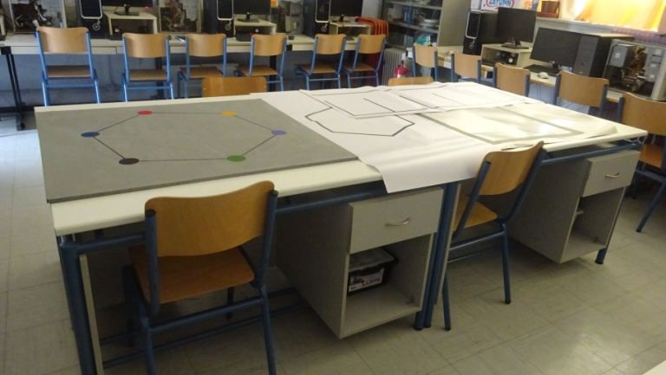
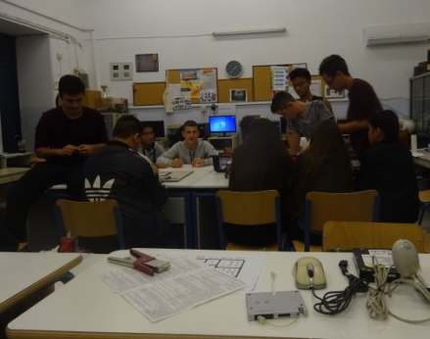
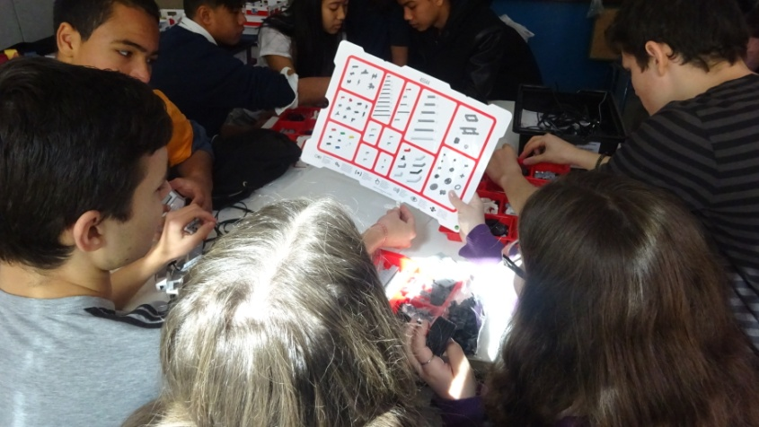
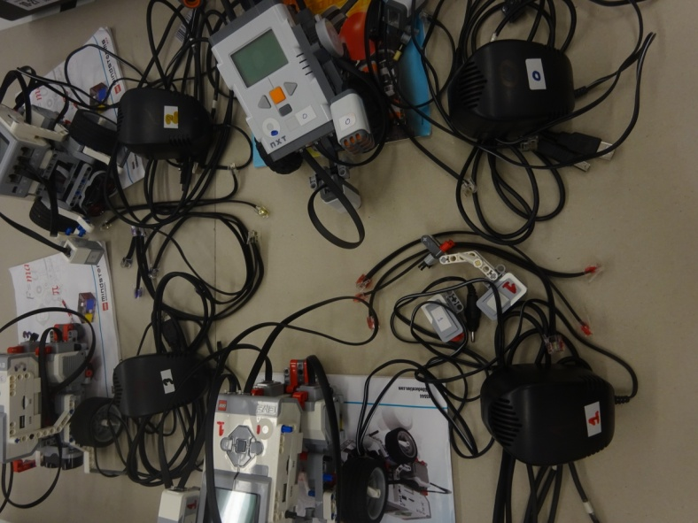
Project implementation and methodology Prepared the implementations (Set up the physical environment, familiarization)
Made the necessary class arrangements
(to create a warm environment where students would be comfortable to work in)
Checked and arranged the Mindstorms core sets+
(made sure all the participants students get to know the lego parts, to reduce the cognitive load of their work)
Notes:
Separated the Core Sets in their Boxes,
Labeled the most significant robots parts,
→(reduce the cognitive load of their work being familiar with the lego parts)
Made the necessary class/ environment arrangements
→(create a cosy, warm environment where they could work pleasantly)
To move freely to their computers. They have space in front of their computers in order to check their programs but they have these 4 desks in the middle of the class to put their tribots and interact them with the others tribots.

Slide 8
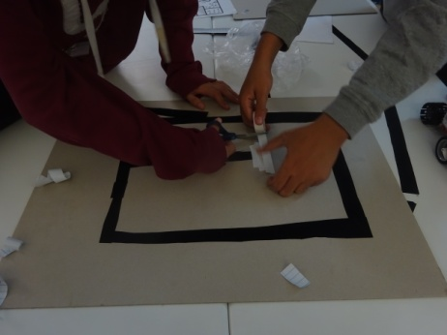
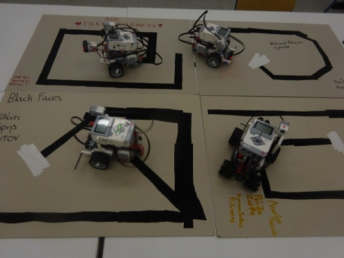
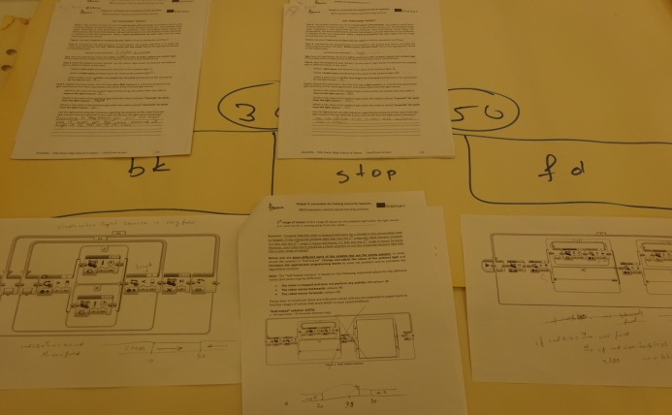
Project implementation and methodology Decided about the activities and the ways they would be introduced
e.g. Ways to understand the problems (mock ups, drawings, helping questions, embodied experiences...)

Slide 9
Project implementation and methodology Process / Methodology
Ages – Attendances
 | Ages – Attendances
 | 1st implementations |  | 2nd implementations
 | Hours (sum) | 12 | Hours (sum) | 14
 | Hours Per Day | 4 | Hours Per Day | 5. 5. 2. 2
 | Dates Of Implementation | 5, 6, 7/04/2016 | Dates Of Implementation | 4,11/11/2016 & 12,17/01/2017
 | Students | 10 | Students | 11
 | Class | 2nd | Class | 3rd
 | Groups | 3 | Groups | 4
 | Ages Of Students | 14-16 | Ages Of Students | 15-16
 | Attendances (1st implementation) |  | Attendances (1st implementation)
 | Number of students (sum=10) | Number of attendances | Number of students (sum=11) | Number of attendances
 | 9 | 3 | 11 | 11
 | 1 | 2
Notes:
We think that the suitable time for robotic activities is between 3 to 4 hours. Beyond the 3rd hour some students feel tired

Slide 10
Project implementation and methodology Process / Methodology
Framework – Selection
School Year: 2016-2017
Students(11 students) chosen between those who:
wanted to take part in the project
met the programs conditions (8 boys -6 of them followed the program the previous year)
- One team was made up of 3 girls, very good students but not very comfortable with technology
School Year: 2015-2016
Students (10 boys) chosen between those who:
met the programs conditions
wanted to take part in the project
Notes:
We think that the suitable time for robotic activities is between 2 to 3 hours. Beyond the 3rd hour some students feel tired

Slide 11
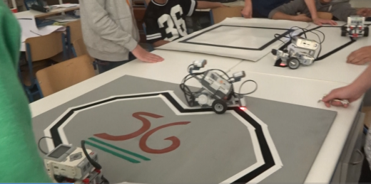
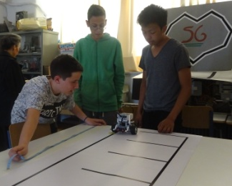
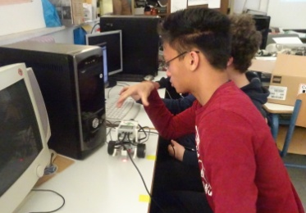
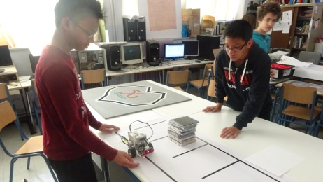
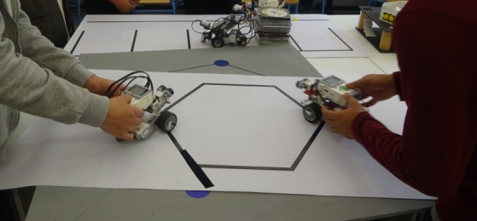
Project implementation and methodology Project activities
Construction of their tribots and scenarios discussed
School Year: 2015-2016
0. Follow the black line
1. The RoboRail
2. Go to park
(parking program)
3. The desert scout (hexagon)
(3 teams/
3 scenarios/
7 programs)

Slide 12
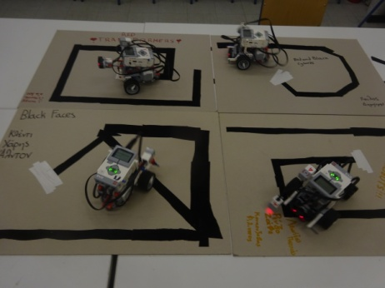
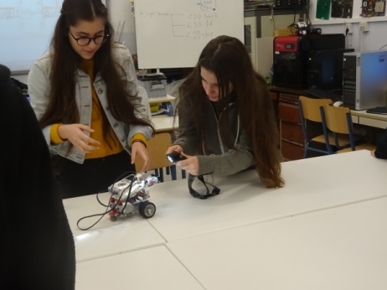
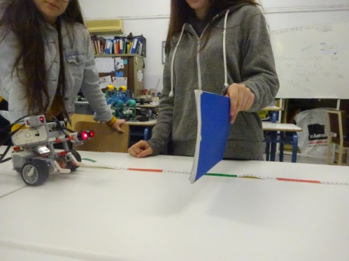
Project implementation and methodology Project activities
Construction of their tribots and scenarios discussed
School Year: 2016-2017
0. Follow the black line
4. Let’s play and dance
5. The sunflower
Follow the black line (mock ups and testing)
(4 teams/
2 scenarios/
10 programs)
Let’s play and dance (short mock up for our scenario)
Programs using light sensors
Programs using ultrasonic sensors

Slide 13
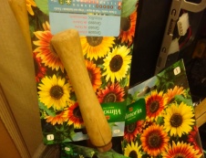
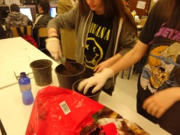
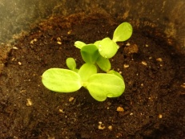
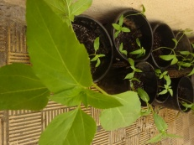
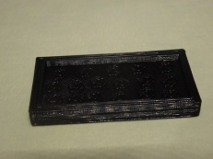
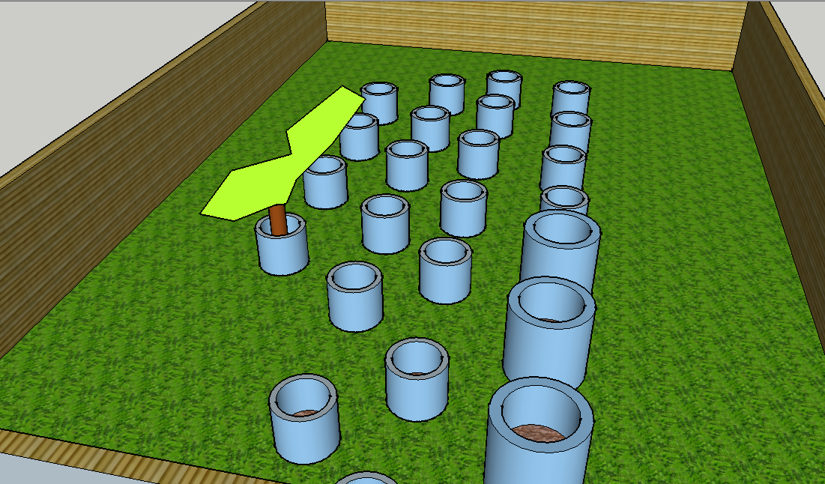
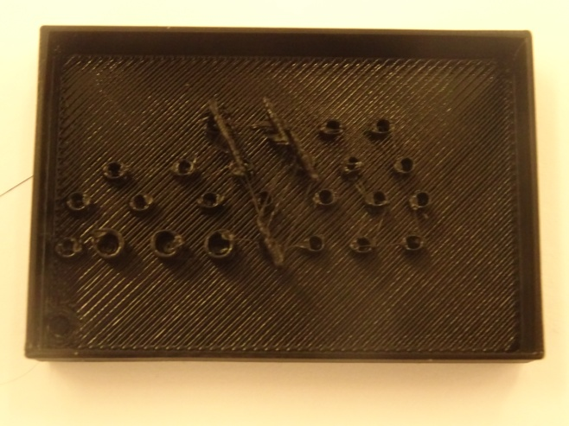
Project implementation and methodology Computer Science – Technology lessons. Interdisciplinary activities about the sunflower effect
Construction of their tribots and scenarios discussed
School Year: 2016-2017 (The sunflower)
1-Program in Scratch/BYOB about the heliotropism
2a-Plant sunflower’s seed
2b-Create a 3D flower bed in sketch up program
2c-Make presentation and videos about the heliotropism effect

Slide 14
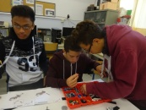
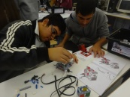
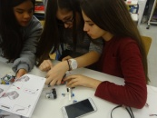
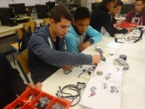
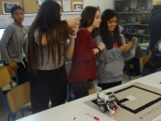
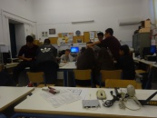
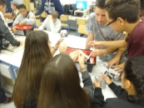
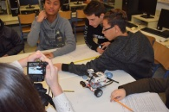
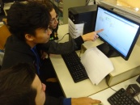
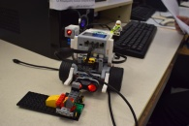
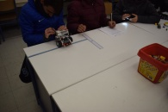
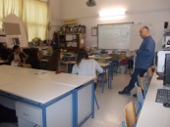
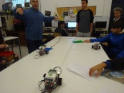
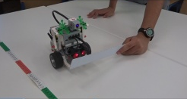
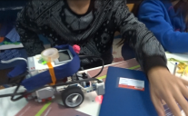
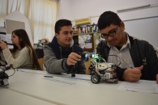
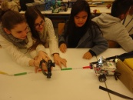
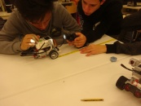
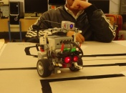
Project implementation and methodology Constructivist pedagogy - Activities
Scaffolding
Zone of approximate development
Creative thinking and involvement through the “transparent” construction of their tangible model (robot/ vehicle EV3)
Our interventions tried to follow the methodology and both constructivist and constructionist approaches proposed in our courses in Athens and Riga
Notes:
In the step “represent the problem”, testing fields were helpful
Teachers: Organizers, Coordinators, Facilitators (organize the learning environment, the learning activities, raise the questions to be solved, helps the pupils when it is necessary, encourage them in their tries/ efforts…)

Slide 15
Project implementation and methodology Problem Based Model*
Identify the problem (understand, motivate)
Represent the problem (drawing, diagram)
Selecting a strategy (choose the appropriate strategy for the problem)
Carry out the strategy (try out the quality of their thinking)
Evaluating results (judge the validity of the solutions)
Analyzing Problem Solving (most important in long-terms goals)
*Eggen, P. & Kauchak, D. (2001). Strategies for teachers: teaching content and thinking skills. Boston: Allyn and Bacon
Notes:
In the step “represent the problem”, testing fields were helpful
Eggen @ Kauchak

Slide 16
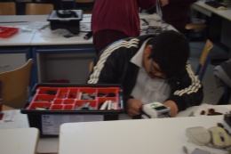
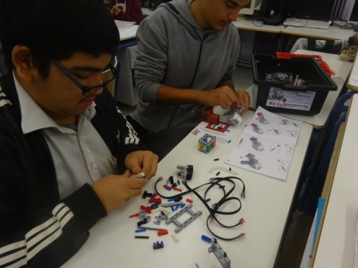
Key Findings / Results quality results / cases
Case1:
Before:
He was antisocial. During breaks he was always against a wall looking at others in the courtyard. In class he was passive.
During the implementation:
He started to discuss with the others. He explained his views and was an active member of the team
After:
He wanted to participate in videos we made about the program (although he was a bit anxious), he wrote the text he communicated in English language himself, he participated as a member of the team in RoboESL exhibition last November in Athens, in the Athens Science Fair too and taught robotic activities to younger students (from our school (1st grade), children in the fair and pupils from the neighboring elementary school) helping in the dissemination of the program
Notes:
The University of Latvia would make the analysis of quantitative results using the google forms filled in by students and teachers before and after each implementation.
We would mention 3 cases

Slide 17
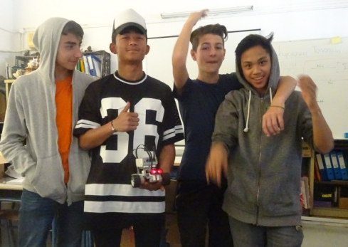
Key Findings / Results quality results / cases
Case2:
Before:
He skipped classes a lot. Before we begun robotic classes he had just exceeded the number of absences. He had to repeat the class..
During the implementation:
He came to robotic lessons and stayed in school all day during the days of our implementation, although he had failed to pass the class due to his absences…
After:
He came several times to lab to work with others team members improving their programs.

Slide 18
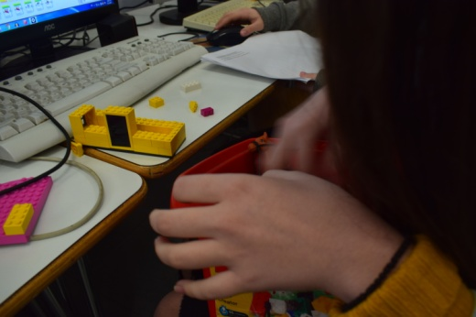
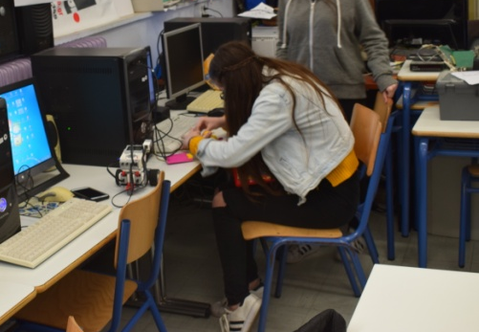
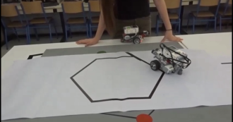
Key Findings / Results quality results / cases
Case3:
During the first hours of the implementation:
She encountered lots of problems constructing the tribot. Consequently she didn’t participate much in the construction and had intense disagreements and quarrels with the other team members. In the end they managed to do the given tasks.
Subsequently…:
She participated in “stories” made for our tribots (the beauty and the beast, the princess and the lover etc) and made some other small constructions using lego parts. She even asked to construct from scratch a tribot and made the programs we had done during our 1st implementation.

Slide 19
Conclusions
Robotics activities can potentially change students’ attitude to learning
Activities, more flexible in time, help students keep pace with the more experienced classmates
Direct feedback help students in the process of learning (when teaching others or presenting their work, they discuss their difficulties and seek the opinion/ approval of their teachers)
The studies have not concluded whether robotic activities has good, neutral or bad effects in the process of learning and students’ attitude toward learning, so each of us has to reach his or her own conclusion -of course there are lots of parameters to be discussed and research should be done.

Slide 20
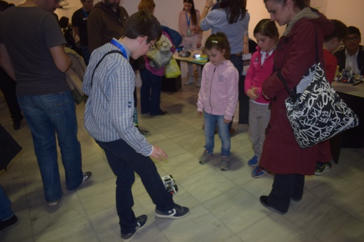
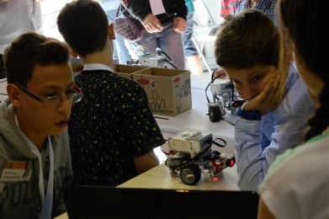
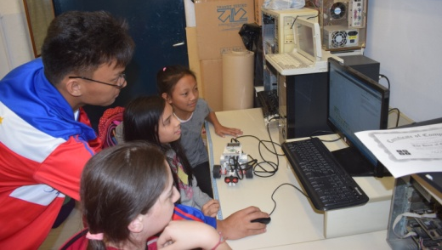
Photos from dissemination of the project Athens Science Festivals 2016 and 2017 / Conference & Exhibition RoboESL / Workshops in our lab

Slide 21
Thanks a lot for your attention ☺
And now a video made by our students is coming about our 2nd implementation...

