Slide 1
“To Water or not to Water” The Arduino approach for optimize irrigation
Panagiotis Karkazis
Panagiotis Balourdos
George Pitsiakos
Konstaninos Asimakopoulos
Ioannis Saranteas
Thomais Spiliou
Dimitra Roussou
ROBOESL project /6th Lab Center of Piraeus

Slide 2
Overview
Early School Leaving and ROBOESL Project
Proposed learning activity
Educational approach
Automated System Design
Automated System Construction
Outcomes

Slide 3
Early School Leaving in vocational education
Early School Leaving (ESL) challenges European education system and economies.
In 2013 5,5 million young people did not complete the secondary education EU.
Reasons of ESL:
Result of a long process of school disappointment.
Social and economic problems.
Educational difficulties.
Boring educational content and practices.
Notes:
This is to state the

Slide 4
Proposed Learning Activity
Students came up with a proposal of a new "project" related to the optimization of the irrigation procedure by designing and implementing an automated system for water management based on an Arduino Uno programing platform.
The fundamental operations are:
The automatic replenishment of water in the water tank and the observation of the water level
Control of the irrigation process (every night)

Slide 5
Educational Approach [1/3]
The proposed activity uses Robotics within the context of education and was based on contemporary theories of learning (constructivism, project-based learning) and student centered approach.
After completing the activity, the students will be able to:
Identify the basic components of automation systems
Design and construct a mechanism for water management
Use appropriate software platforms in order to control the automation
Compare and evaluate suggested solutions both for the construction as well as for the software programming

Slide 6
Educational Approach [2/3]
The proposed activity was executed and evaluated on five phases:
Problem definition phase
This is the initial phase of the process were the students try to define the irrigation problem and all the related factors which can have positive or negative impact on the given problem
Experimental phase
The students experimented on the Arduino platform tools based on their observations from the previous phase and tried to find solutions to the problems

Slide 7
Educational Approach [3/3]
Design phase
Students divided the problem into smaller individual “sub-problems” and tried to find solutions by forming groups of 2 or 3
Construction phase
After solving individual “sub-problems” and developing the "subsystems" of the automation, students made the interconnections between them, based on the design
Evaluation phase
Each group presented their outcomes based on:
The performance of the system
The problems faced during their work
Collaboration within the working group

Slide 8
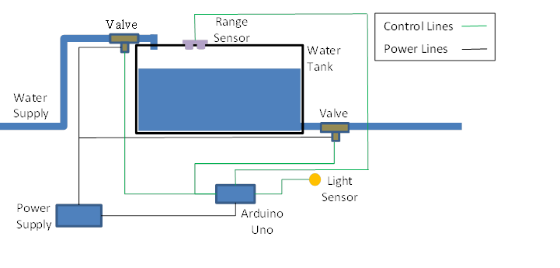
The automated system [1/3]
System Design

Slide 9
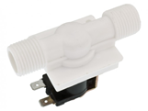
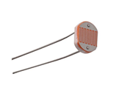
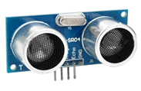
The automated system [2/3]
System peripherals
Arduino Uno microcontroller board
Solenoid Valves
Electronic components and devices(DC power supply, transistors, resistors, Photo resistors etc)
Ultrasonic sensor (HC-SR04)

Slide 10
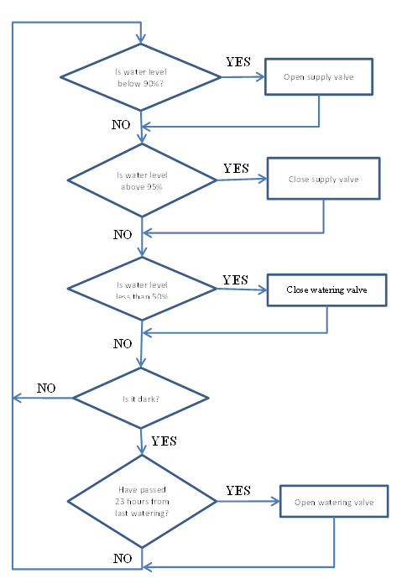
The automated system [3/3]
Software logic
The tank refills whenever the water level drops below 90% (Supply valve opens)
The water refill stops whenever the tank level gets above 95% (Supply valve closes)
Irrigation begins when it is dark and at least 23 hours have passed since the last watering (Watering valve opens)
Watering stops when the water level drops below 50%. (Watering valve closes)

Slide 11
System Construction

Slide 12
Outcomes
The proposed educational activity was based on the principles of the constructionism and used the Arduino Uno platform within the Erasmus RoboESL Program
Results from Students side:
High enthusiasm
Developed teamwork spirit by exchanging ideas and potential solutions from different technological fields
Discovered the importance and the power of “learning how to learn”
From Teachers side:
Work exclusively with students who have learning difficulties

Slide 13
Thank you

