Slide 1



ATEE Spring Conference 2017
ROBOESL Conference
12.05.2017| Riga
Teacher Education in Educational Robotics:
the ROBOESL Project discourse
Dr. Dimitris Alimisis, EDUMOTIVA, Greece
ERASMUS+ Project RoboESL: 2015-1-IT02-KA201-015141

Slide 2


Slide 3

The consortium consists of 7 partners
Liceo E. Fermi (coordinator) (Italy)
Scuola di Robotica (Italy)
Università degli studi di Padova (Italy)
Edumotiva- European Lab for Educational Technology (Greece)
6EK A PEIRAIA (Greece)
7th Secondary Education School Committee of Athens Municipality (Greece)
Valmieras 5.vidusskola (Latvia)
Latvijas Universitate (Latvia)

Slide 4
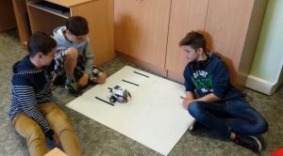
The RoboESL project aims…
To highlight the potential of educational robotics for schools in order to help children at risk of failure or Early School Leaving
to practice and develop children’s creativity skills
To raise self-esteem,
To motivate interest in schooling,
To encourage towards staying at school
ERASMUS+ Project RoboESL: 2015-1-IT02-KA201-015141

Slide 5
3 main intellectual outputs
Output 1 Open Educational Resources for 10 exemplary interdisciplinary robotics projects freely available for teachers and students
Output 2 A curriculum for teacher training course to enhance educational robotics uptake in teaching and learning
Output 3 Validation report on the impact of the robotics projects on the selected students’ achievements and attitudes
ERASMUS+ Project RoboESL: 2015-1-IT02-KA201-015141

Slide 6
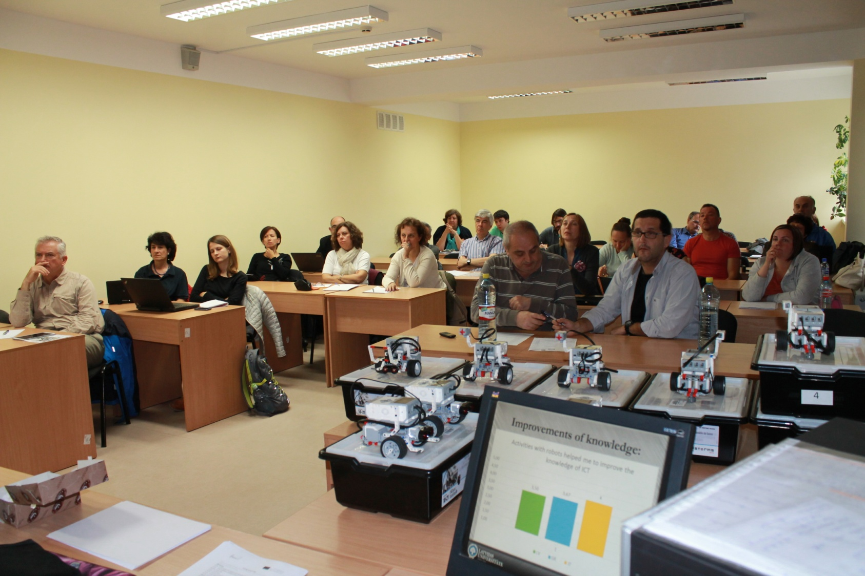
ROBOESL for teachers…
1st teacher training course in Athens, GR
2nd teacher training course in Riga, LT
3rd teacher training course in Genoa, IT
ERASMUS+ Project RoboESL: 2015-1-IT02-KA201-015141

Slide 7
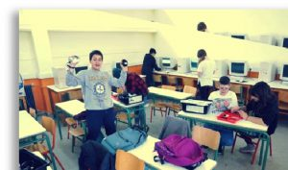
ROBOESL for school students…
Robotics activities in schools in
Athens and Piraeus, GR
Genoa, IT
Valmiera, LV

Slide 8
Changing teacher’s role
ER methodology requires that learners themselves are active with a high need to explore, to design, to create and to share experiences and ideas
Hence, teachers in ROBOESL training paradigm are encouraged to change their role to facilitators and enablers
They learn to design and implement relative simple robotic projects in the context of scenarios from everyday life using robotics kits

Slide 9
The role of the teacher: 3 not
not to ensure that students solve the problems and run projects in the way anticipated by the teacher
nor just follow steps to arrive at a pre-defined result
Teacher does not function as an intellectual “authority” that transfers ready knowledge to students

Slide 10
The role of the teacher
acts as an organizer, coordinator and facilitator of the learning process.
organizes the learning environment,
raises the tasks / problems to be solved
offers resources
supports students’ engagement in the ROBOESL interdisciplinary projects
discreetly helps where and when necessary
encourages students to try out different ideas and solutions and to work in teams
organizes the evaluation of the activity in collaboration with the students.
ensures a playful, open, non-judgmental, and collaborative classroom environment that fosters creativity and collaboration

Slide 11
Educational methodology
constructivist/constructionist pedagogy (Piaget, Papert)
project-based learning approach
active reflection upon the task

Slide 12
Educational methodology
experiential learning and learning by making
instead of giving step-by-step instructions, teachers/learners are advised to try and figure out how to do it themselves

Slide 13
The curriculum: aim
enabling teachers to master the technical and pedagogical skills
to become able to develop their own robotics activities
Learn to use innovative, student-centered and constructivist pedagogical approaches
focus on preventing School Failure and Early School Leaving.

Slide 14
Main objectives…
To promote learning through interaction of the trainee with the robotics technologies
To support self-directed action allowing trainees to learn independently.
To support the development of “real” training scenarios encouraging the engagement of the trainee in authentic problem solving .
To adjust training to trainee’s needs and interests by offering training tasks with options to advance to different levels of difficulty
Finally to provide methodology and tools for the overall evaluation of the training program.

Slide 15
content
pedagogical approaches to cope with school failure/ESL
robotics-based learning methodologies inspired from constructivism and project-based learning principles
training activities for familiarisation with educational robotics using robotics kits and software
guidelines for using resources
Worksheets for exemplary robotics-based learning activities
evaluation guidelines and tools (to be used in O3) for validating the impact of robotics-based learning activities on the prevention of school failure/ESL
validation criteria and tools for validating the impact of the curriculum on the participant teachers.

Slide 16
Training activity 1
3 different teaching practices
Three teachers introduce for first time robotics in their class.
Teacher A starts with a presentation of the Lego Mindstorms kit together with projection of slides that show in detail the content of the kit and demonstrates in front of the class how to make a first robotic construction
Teacher B divides the class in groups of 3-4 students, provides a Lego Mindstorms kit for each group and a handbook with step by step instructions to make a robotic car.
Teacher C divides the class in groups of 3-4 students, provides a Lego Mindstorms kit for each group, then encourages and help students to explore the content of the kit, and invite them to try out a first robotic construction of their own choice

Slide 17
Scenario
Imagine a train travelling in a straight rail. The distance between two successive stations is the same. A train runs over this rail travelling at constant speed on the track between two stations, and stops for some time at each station before leaving again. When it reaches the end of line, it waits a bit longer and then it comes back in reverse way towards the starting station.
Make a robot to emulate the train on the monorail. ..

Slide 18
Discuss within your group the scenario…
How can you make the robot to follow the sides of a regular polygon of 6 sides and to collect some data, namely the color code of a piece of paper or tape put on each vertex reporting the maximum value?

Slide 19
Thinking before acting…
Form and write down a methodology to solve this problem…

Slide 20
Making a mock up…
Draw the rail with a straight line and some stations in the same distance on a long sheet of paper and put it on the table or on the floor or put directly on the table or on the floor some short pieces of tape in same distance to stand for the stations.

Slide 21
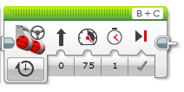
Explorations…
Examine how the block Move Steering works
Exploration: Set the duration in seconds. How many seconds the train needs to travel from one station to the next one?
Write your answer here ………………………….
How did you find this answer? ……………………

Slide 22

Only the necessary guidance
Task 7. Here comes the sound! Experiment with the sound block to make the robot play sounds.
Type: Play note
Duration
Wait for completion
Volume
Note textual code

Slide 23
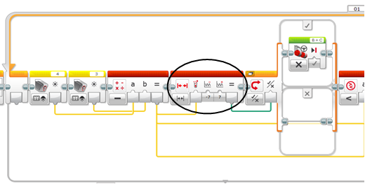
“Half-baked” solutions…
Below you can find a “half-baked” solution. This means that some parts are missing and some values needs to be adjusted. Can you complete the algorithmic solution?

Slide 24
Not revealing answers…
Now make your train to travel all the line stopping in each station for some seconds.
Can you think of a command that would help to make the programming task easier?
Write your idea here ……………………

Slide 25
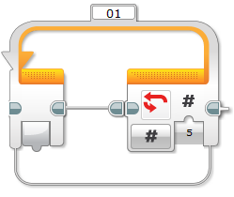
Or revealing solutions at the right moment…
Here is the Loop block to repeat the motion as many times as you wish.
You can insert your blocks inside one Loop block.
Make your train to travel all the line using the Loop block.

Slide 26
Experimentations…
Experiment how to make the robot turn 90 degrees

Slide 27
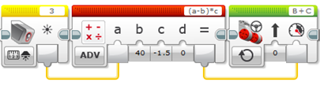
“What if” experimentations
Task 8. Check what will happen if you integrate the “advanced math block” among the two blocks that you have already built.
What happens when a equals to b? …………………………………………………………….
What happens when a is bigger than b? ………………………………………………………..
What happens when b is bigger than a? …………………………………………………………..

Slide 28
Going beyond trial and error strategies
What happens if the distance between the stations changes? Working again with the “trial and error” method takes time!
Let’s use some maths to make the train to travel the distance between the stations.

Slide 29
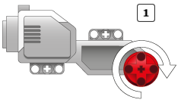
Trying out a scientific method…
Remember! When the wheel rotates 360 degrees (1 full rotation) the robot travels 2πR distance (R=radius of the wheel).
Write here your solution ……………..
Check your solution, does it work?
2πR

Slide 30
Task 8. Study in the following sketch how the tribot turns around the stopped wheel. Can you think of a mathematical reasoning underpinning the relation between the rotations of the motor and the turning angle of the tribot?
d

Slide 31
Embodiment → embodied cognition
How to instruct the robot to move in a triangle?
Play the robot with your own body using your own senses

Slide 32
Inductive method
Years ago S.Papert formulated the Turtle total trip theorem: the turtle will draw a closed figure with n sides when the sum of the angles turned is 360.
What is the angle to turn each time to draw a triangle? ………………………
If you get it right the turtle will draw a closed triangle. Try it with your tribot.
What is the angle to turn each time to draw a square? ………………………
Confirm this with your tribot.
Now what is the angle to turn each time to draw a hexagon? ………………………
Confirm again with your tribot

Slide 33
Try again and again your parking project until you succeed!
Encouragement…

Slide 34
Encouraging team work
Can you think of another solution that would give a more precise behavior? Discuss with your partners and briefly document your ideas.
---------------------------------------------------------------------------------------------------------------------------------------------------------------------------------------------------------------------------------------------------------------------------------------------------------------------------------------------------------------------------------------------------------------------------------------------------------------------------------------------------------------------------------------------------------------------------------------------------------------------------------------

Slide 35
Encouraging sharing of ideas…
Task . Start programming your robot to skip just one obstacle. Repeat your trials until you succeed. Describe here your programming solution in your own words for further discussion.

Slide 36
Encouraging reflections…
Task. Prepare with your group a short presentation of your final solutions in the class, reflect with critical mind on your work, on comments and evaluation. After that write down your personal experiences from this project in your diary.

Slide 37
The curriculum will become freely available on line with open access www.roboesl.eu
for more
www.edumotiva.eu
info@edumotiva.eu

